Slide 1
6.2 Logistic Regression and the Cross Entropy Cost

Slide 2
In this Section we describe a fundamental framework for linear two-class classification called logistic regression.
In particular we employ the Cross Entropy cost function.
Logistic regression follows naturally from the regression framework regression introduced in the previous Chapter.
The added consideration here is that data output is now constrained to take on only two values.

Slide 3
Notation and modeling

Slide 4
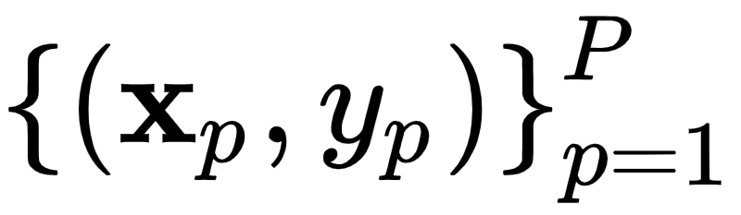
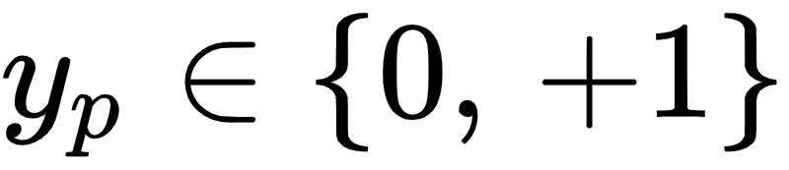
Two class classification is a particular instance of regression or surface-fitting.
Here the output of a dataset of P points is no longer continuous but takes on two fixed numbers.
The actual value of these numbers is in principle arbitrary, but particular value pairs are more helpful than others for derivation purposes.
Here we will use the values - that is every output takes on either the value 0 or +1.

Slide 5
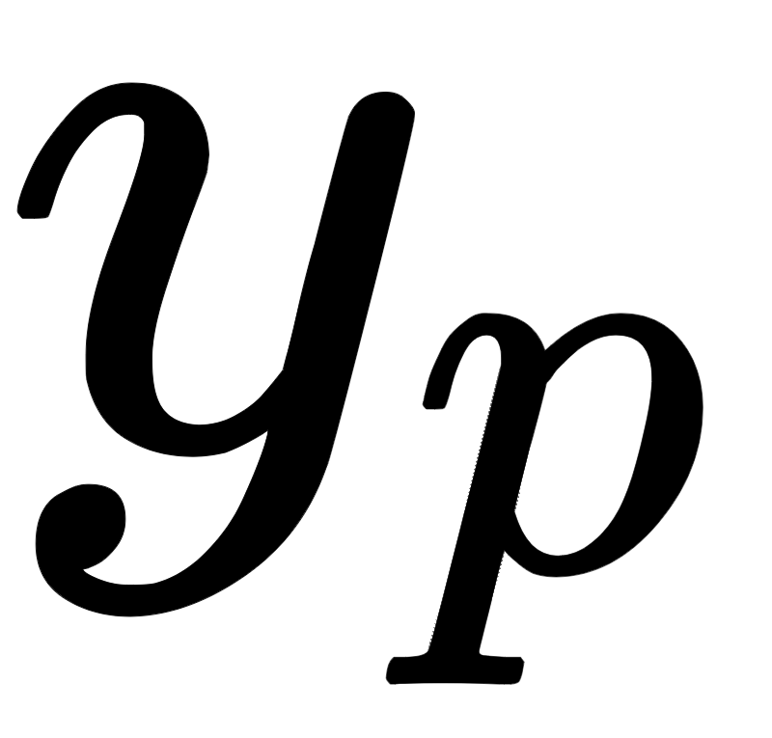
Often in the context of classification the output values are called labels, and all points sharing the same label value are referred to as a class of data.
Hence a dataset containing points with label values is said to be a dataset consisting of two classes.

Slide 6
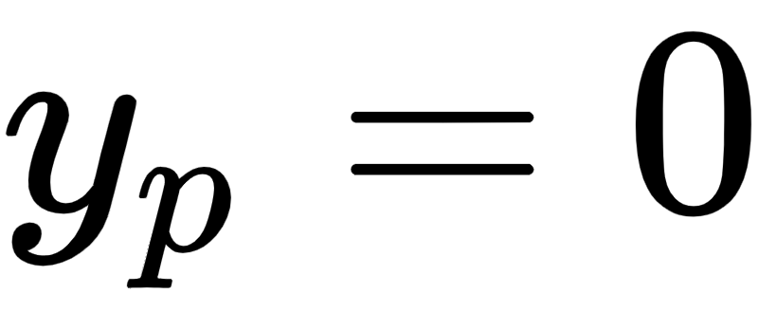
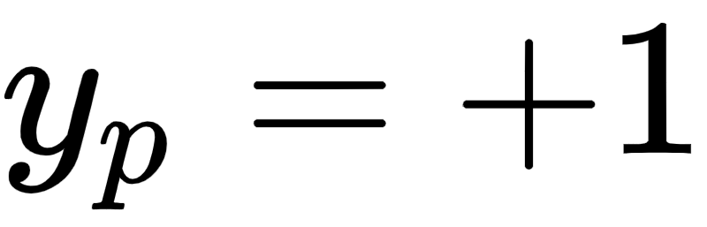
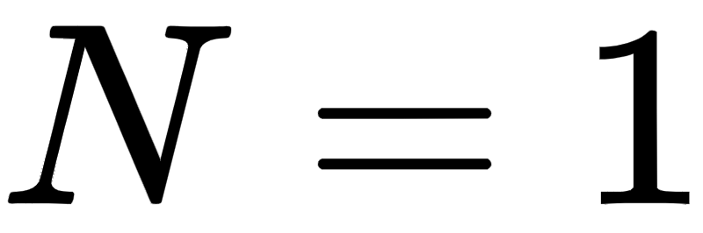
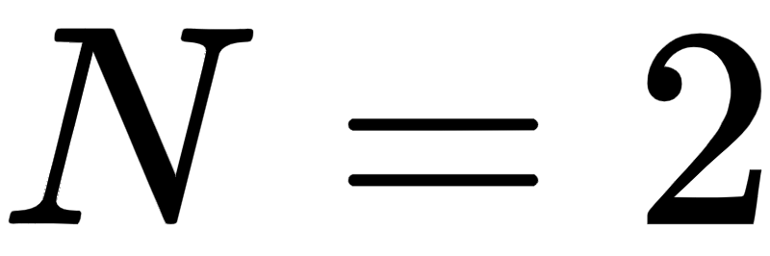
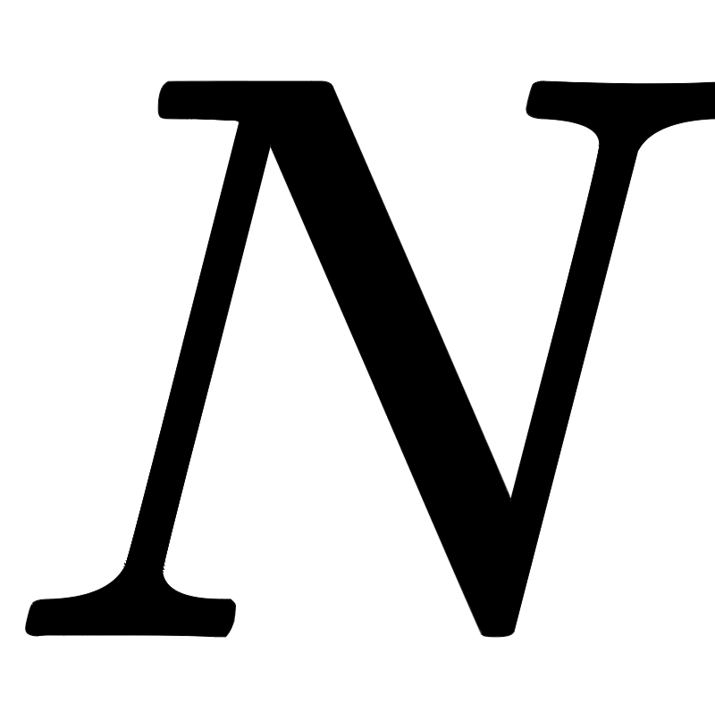
The simplest shape such a dataset can take is that of a set of linearly separated adjacent 'steps', as illustrated in the figure below.
Here the 'bottom' step is the region of the space containing most of the points that have label value .
The 'top step' likewise contains most of the points having label value .
These steps are largely separated by a point when , a line when , and a hyperplane when is larger.

Slide 7
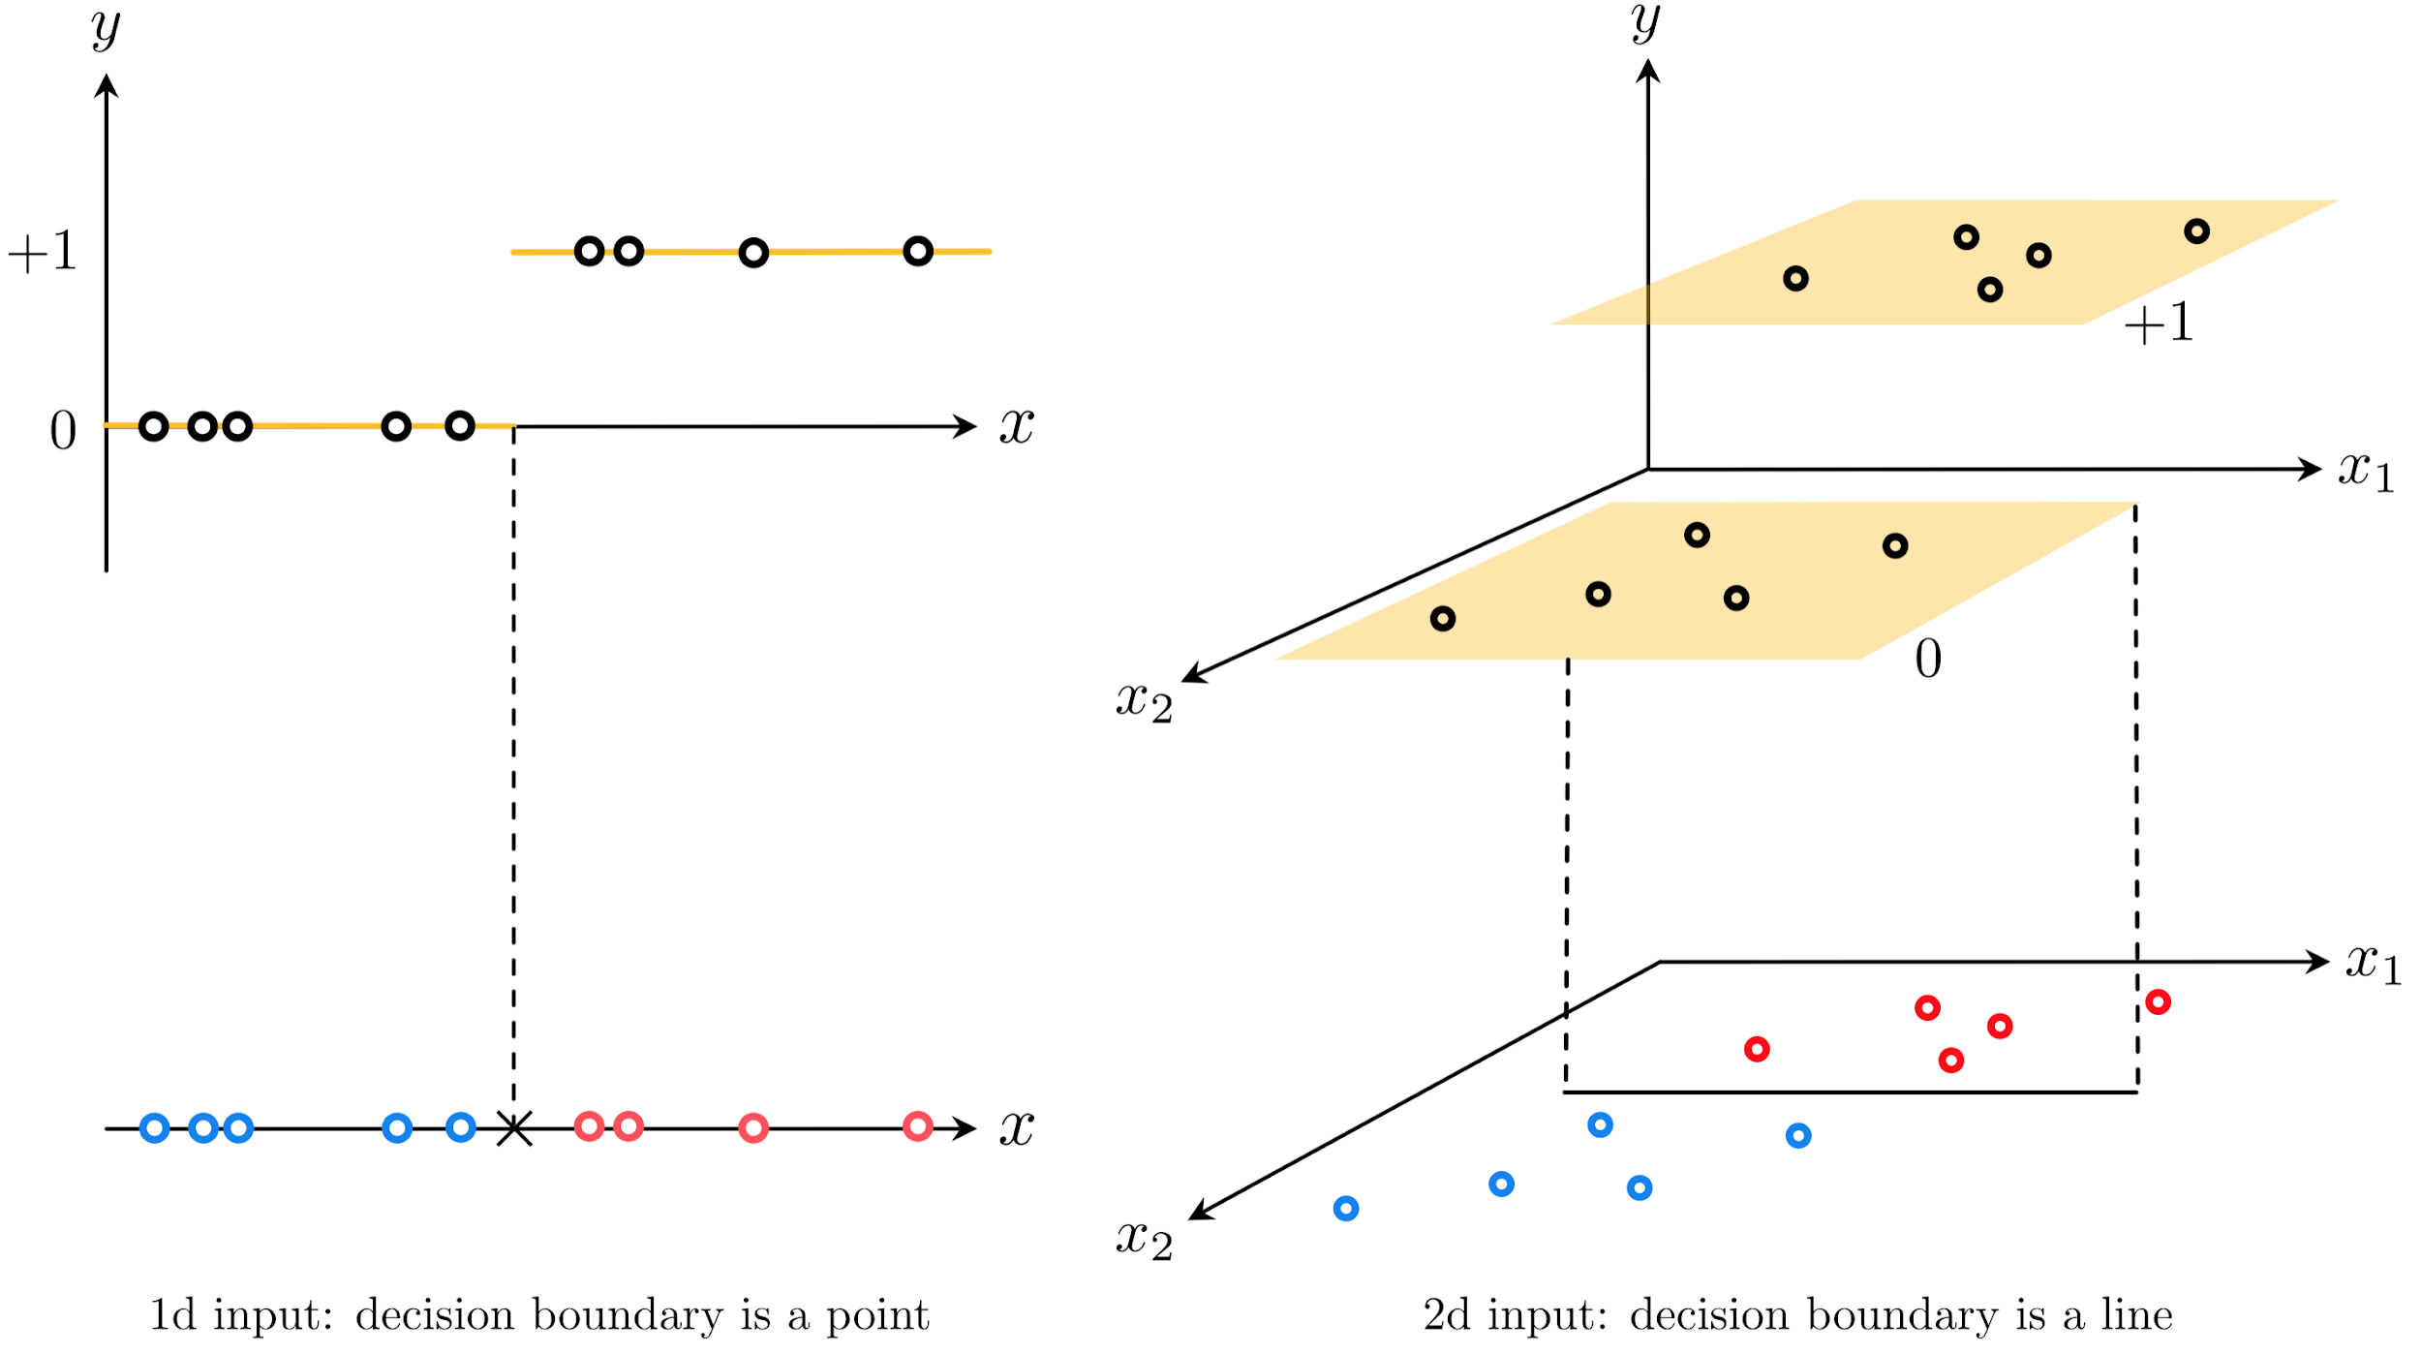

Slide 8
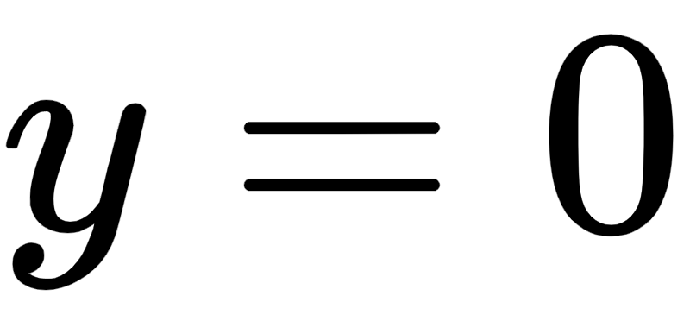
As shown in the figure, because its output takes on a discrete set of values one can view a classification dataset 'from above'.
That is looking down from a point high up on the y axis (or in other words, the data projected onto the plane ).
From this perspective we remove the vertical y dimension of the data and visually represent the dataset using its input only.
We display the output values of each point by coloring its input one of two unique colors (we choose blue for points with label , and red for those having label ).

Slide 9
This is the simplest sort of dataset with binary output we could aim to perform regression on - one with a linear boundary.
More generally the boundary could certainly be nonlinear.
We will deal with this more general potentiality later on - when discussing neural networks, trees, and kernel-based methods.
But first we deal with the current scenario: How can we perform regression on a dataset like the ones described in the figure above?

Slide 10
Trying to fit a discontinuous step function

Slide 11
How can we fit a regression to data that is largely distributed on two adjacent steps separated by a hyperplane?
Lets look at a simple instance of such a dataset when to build our intuition about what must be done in general.

Slide 12
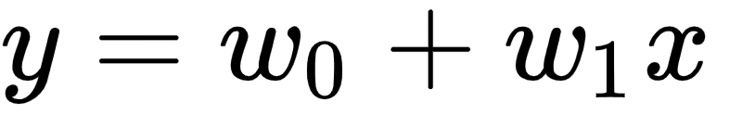
Intuitively it is obvious that simply fitting a line of the form to such a dataset will result in an extremely subpar results.
The line by itself is simply too inflexible to account for the nonlinearity present in such data.
A dataset that is roughly distributed on two steps needs to be fit with a function that matches this general shape.
In other words such data needs to be fit with a step function.

Slide 13
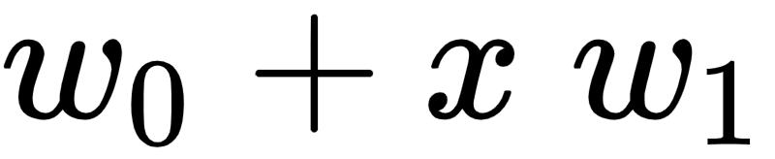
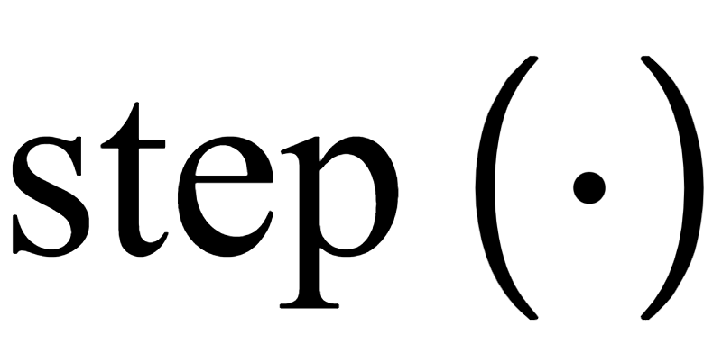
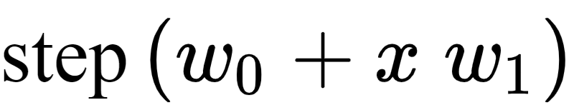
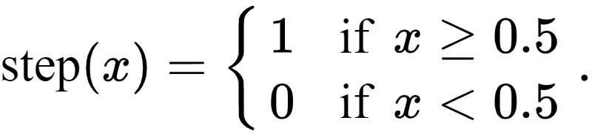
So ideally we would like to fit a discontinuous step function with a linear boundary to such a dataset.
When a linear model defining this boundary is just a line composed with the step function as
where the step function is defined as

Slide 14
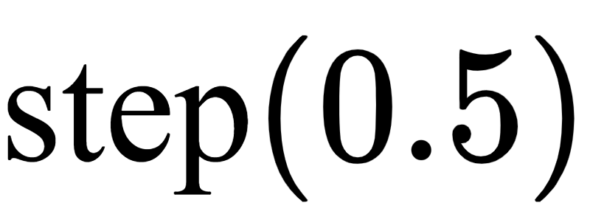
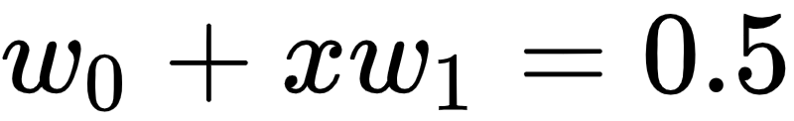
Note here that what happens with is - for our purposes - arbitrary (i.e., it can be set to any fixed value or left undefined as we have done).
The linear boundary between the two steps is defined by all points x where

Slide 15
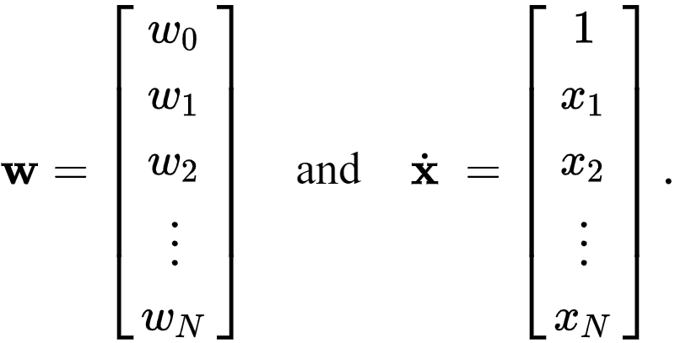
More generally with general dimensional input we can write the linear model defining the boundary as employing our compact vector notation first introduced in [Section 5.2]

Slide 16
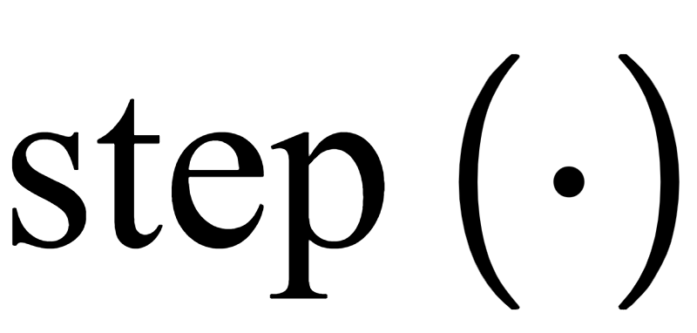
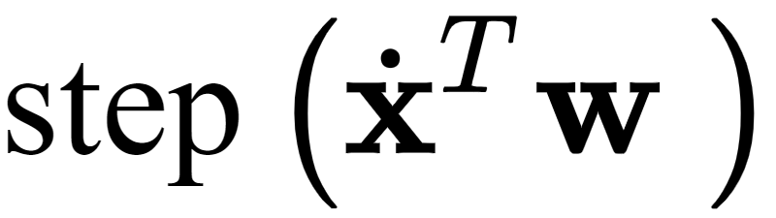

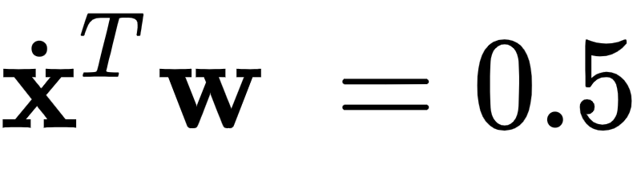
A corresponding step function is then simply the of this linear combination
and the linear boundary between the steps is defined by all points where .

Slide 17
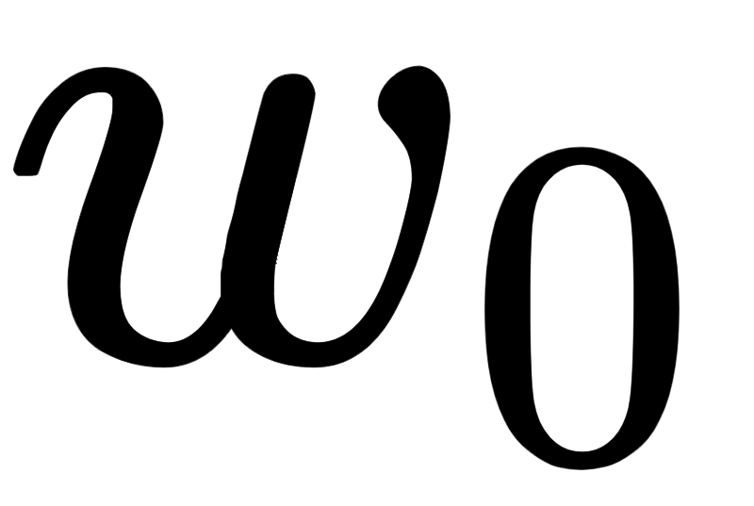
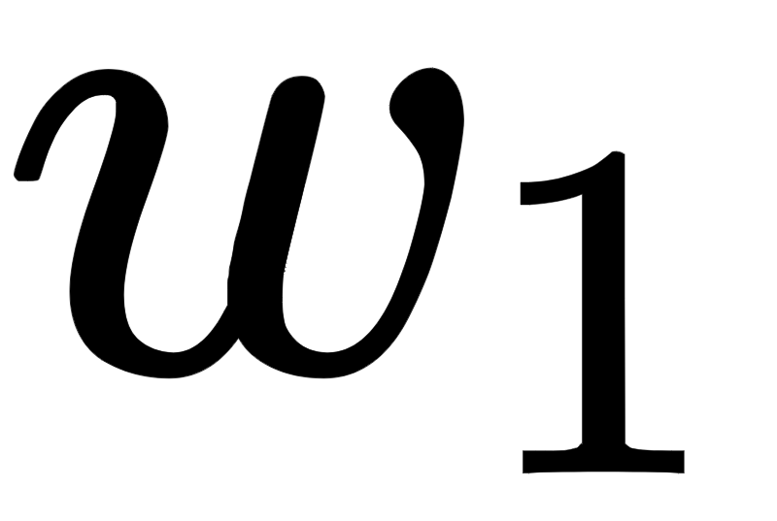
How do we tune the parameters of the line?
We could try to take the lazy way out and first fit the line to the classification dataset via linear regression, then compose the line with the step function to get a step function fit.
However this does not work well in general - as we will see even in the simple instance below.
Instead we need to tune the parameters and after composing the linear model with the step function, or in other words we need to tune the parameters of

Slide 18
Example: Fitting a line first and taking the step afterward fails to represent a two-class dataset well

Slide 19
Below we load in a simple two-class dataset (top panel), fit a line to this dataset via linear regression,
We then compose the fitted line with the step function to produce a step function fit.
Both the linear fit (in green) as well as its composition with the step function (in dashed red) are shown along with the data in the bottom panel.

Slide 20
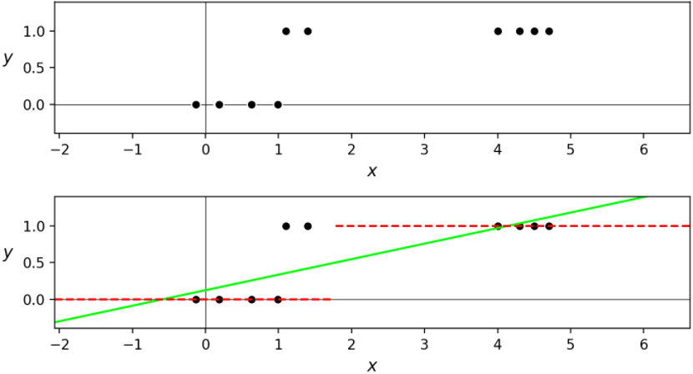

Slide 21
Of course the line itself provides a terrible representation of the nonlinear dataset.
But its evaluation through the step is also quite poor for such a simple dataset, failing to properly identify two points on the top step.
In the parlance of classification these types of points are referred to as misclassified points.

Slide 22
How do we tune these parameters properly?
As with linear regression, here we can try to setup a proper Least Squares function that - when minimized - recovers our ideal weights.
We can do this by simply reflecting on the sort of ideal relationship we want to find between the input and output of our dataset.

Slide 23
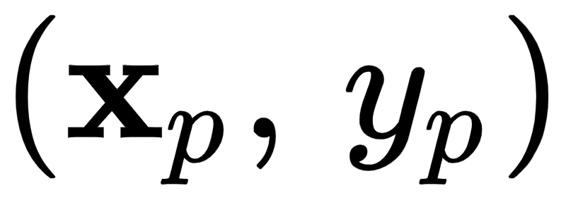
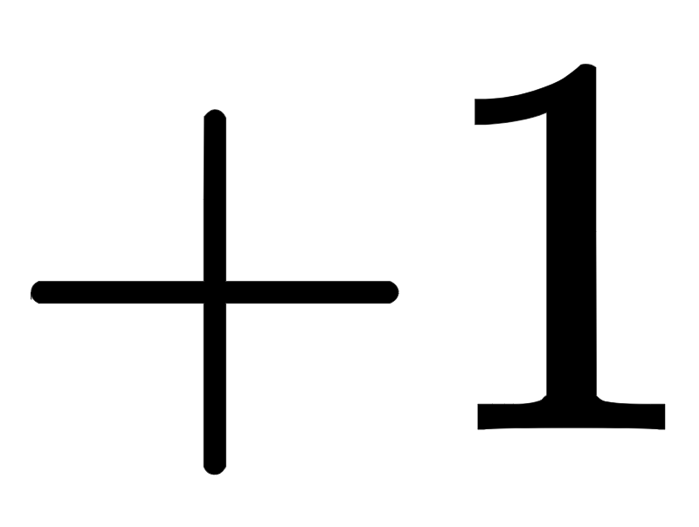
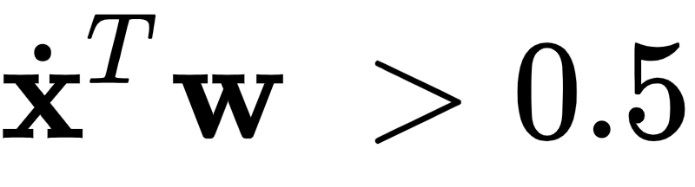
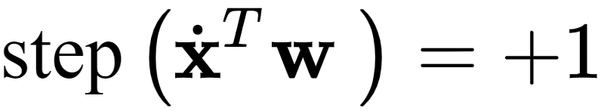
Take a single point .
Notice in the example above that ideally for a good fit we would like our weights to be such if this point has a label it lies in the positive region of the space.
That is where so that matches its label value.

Slide 24
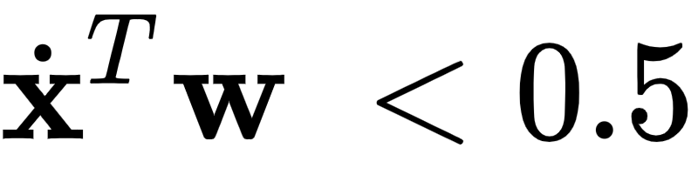
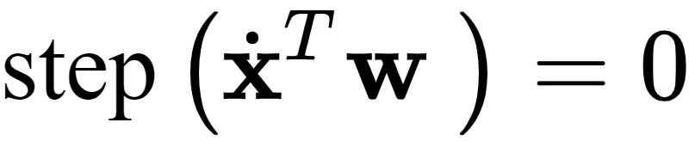
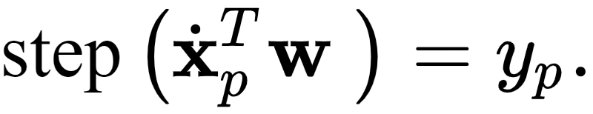
Likewise if this point has label 0 we would like it to lie in the negative region where so that matches its label value.
So in short what we would ideally like for this point is that its evaluation matches its label value, i.e., that
And of course we would like this to hold for every point.

Slide 25

To find weights that satisfy this set of P equalities as best as possible we could square the difference between both sides of each and average them.
This gives the Least Squares cost function

Slide 26
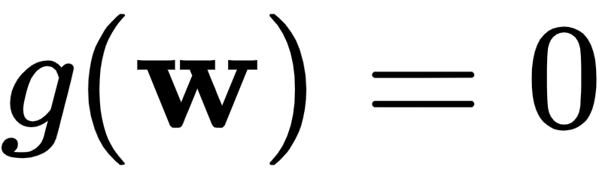

We could then try to minimize this cost in order to recover weights that satisfy our desired equalities.
If we can find a set of weights such that then all equalities above hold true, otherwise some of them do not.

Slide 27
Unfortunately because this Least Squares cost takes on only integer values.
In other words, it is impossible to minimize with local optimization (e.g., gradient-based techniques), as at every point the function is completely flat.
Because of this local optimization cannot easily take even a single step 'downhill' regardless of where they are initialized.
This problem is inherited from our use of the step function, itself a discontinuous step.

Slide 28
Example: Visualizing various cost functions on a toy dataset

Slide 29
In the next Python cell we plot the Least Squares shown above (left panel) for the dataset displayed in Example 1.
In the middle and right panels we plot the surfaces of two related cost functions on the same dataset.
We introduce the cost function shown in the middle panel in the next subection, and the cost in the right panel in the one that follows.
We can indeed minimize either of these using a local method to recover ideal weights.

Slide 30
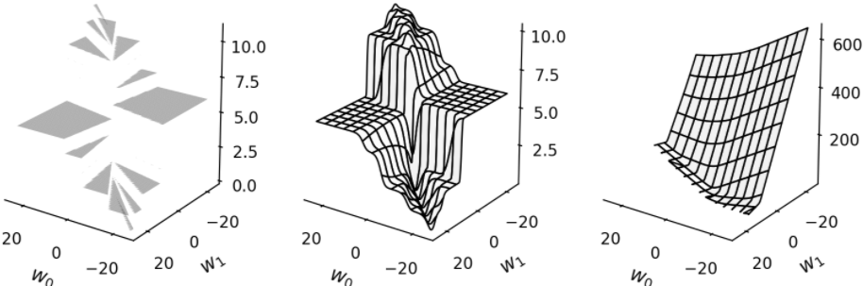

Slide 31
The logistic sigmoid function

Slide 32
As mentioned above, we cannot directly minimize the Least Squares above due to our use of the step function.
In other words, we cannot directly fit a discontinuous step function to our data.
In order to go further we need to replace the step, ideally with a continuous function that matches it very closely everywhere.

Slide 33
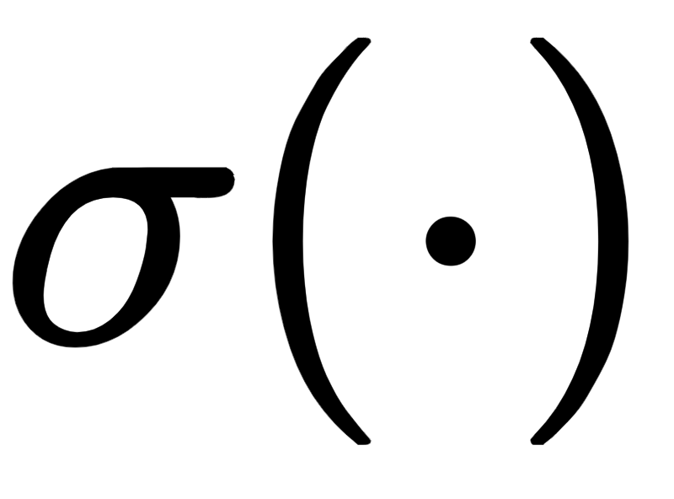
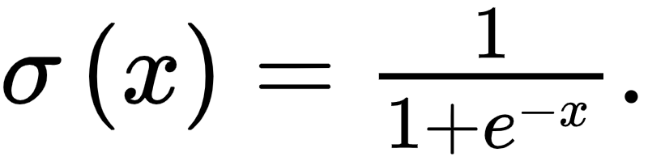
Thankfully such a function is readily available: the sigmoid function,
This kind of function is alternatively called a logistic or logistic sigmoid function.
When we fit such a function to a classification dataset we are therefore performing regression with a logistic or logistic regression.

Slide 34
In the figure below we plot the sigmoid function (left panel), as well as several internally weighted versions of it (right panel).
As we can see in the figure, for the correct setting of internal weights the hyperbolic tangent function can be made to look arbitrarily similar to the step function.

Slide 35
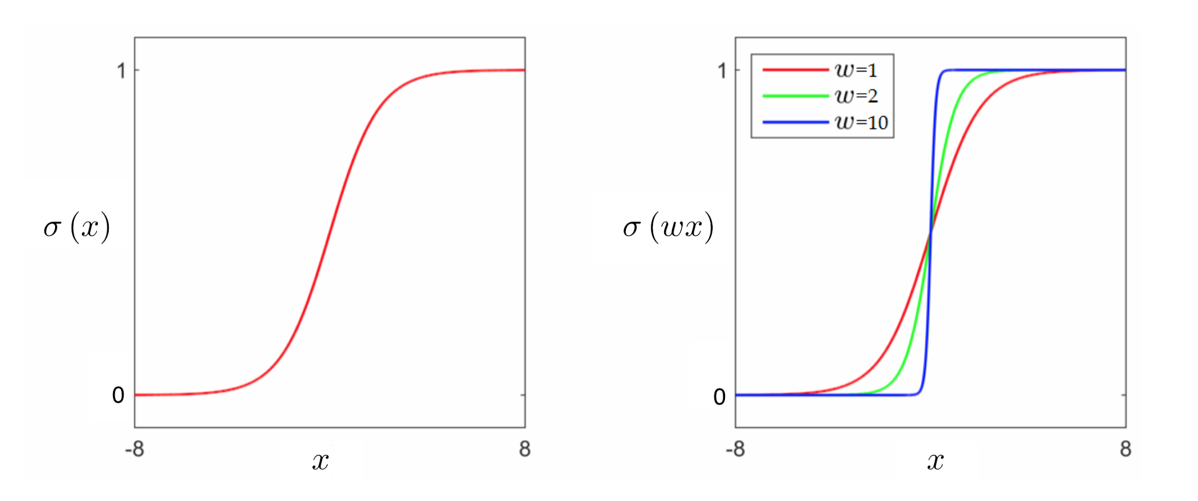

Slide 36
Logistic regression using the Least Squares cost

Slide 37
Swapping out the step function with the sigmoid we aim to satisfy as many of the P equations that follow hold
To learn parameters that force these approximations to hold we can do precisely what we did in the case of linear regression
We can try to minimize the e.g., the squared error between both sides constructing the Least Squares point-wise cost

Slide 38

Taking the average of these squared errors gives a Least Squares cost for logistic regression
This function - an example of which is plotted above in the middle panel - is generally non-convex and contains large flat regions.
This can make it difficult, but not impossible, to minimize properly using some local methods (e.g., standard gradient descent and Newton's method).

Slide 39
Specialized algorithms - like the normalized gradient descent schemes presented in [Section 3.9] - can be employed successfully as we show in the example below.
However it is more commonplace to simply employ a different and *convex* cost function based on the set of desired approximations.
We do this following the example.

Slide 40
Example: Normalized gradient descent for Least Squares logistic regression

Slide 41
In this example we show how normalized gradient descent can be used to minimize the logistic Least Squares cost,
First we translate this cost into Python below.

Slide 42
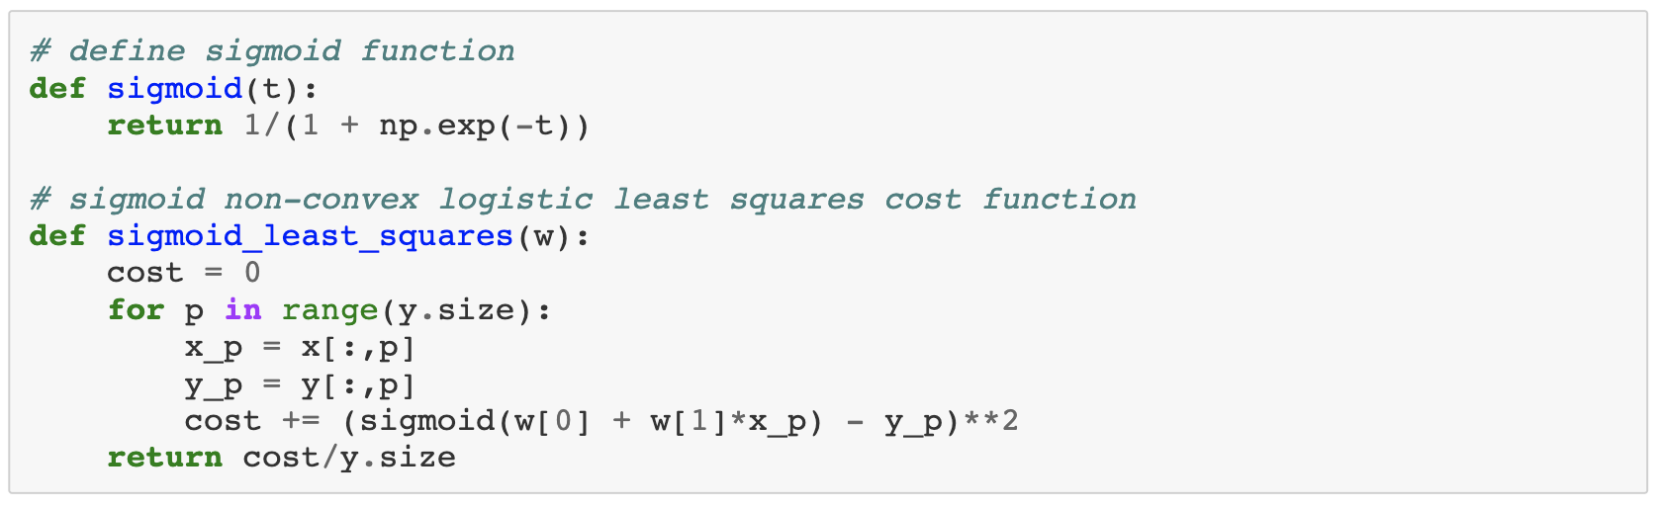

Slide 43
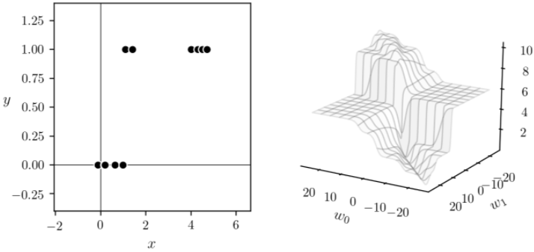

Slide 44

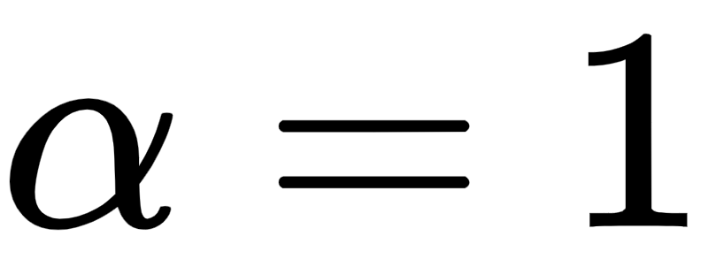
We now run normalized gradient descent for 900 iterations, initialized at , with steplength parameter fixed at .
The cell below plots the Least Squares logistic regression fit to the data (left panel) along with the gradient descent path towards the minimum on the contour plot of the cost function (right panel).
The normalized gradient descent steps are colored green to red as the run progresses.

Slide 45
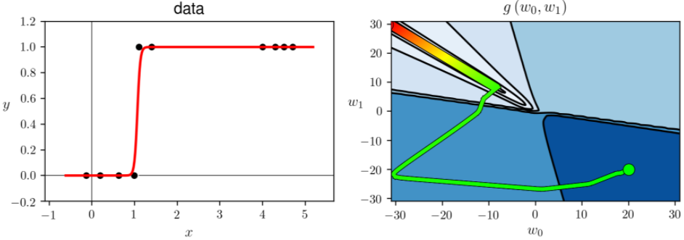

Slide 46
Logistic regression using the Cross Entropy cost

Slide 47
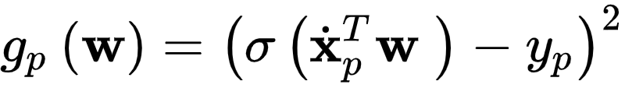
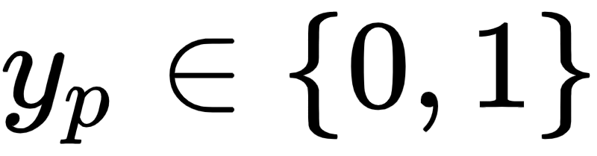
There is more than one way to form a cost function whose minimum forces as many of the P equalities to hold as well as possible.
The squared error / point-wise cost penalty works universally, regardless of the values taken by the output by .
However because we know that the output we deal with now is limited to the discrete values it is reasonable to ask if we cannot create a more appropriate cost that is customized to deal with just such output.

Slide 48
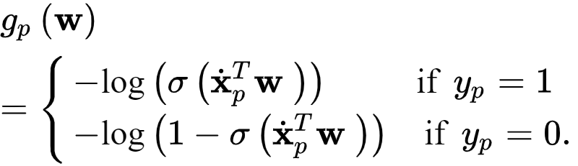
Such a point-wise cost does exist for these restricted output values.
One such cost - which we call the Log Error - is as follows

Slide 49
First notice that regardless of the weight values this point-wise cost is always nonnegative and takes on a minimum value at 0.
Second notice how this penalizes violations of our desired equalities in equation (4) (and much more harshly than a Least Squares cost too).
A plot showing both the Least Squares and Log Error point-wise costs are shown below.

Slide 50
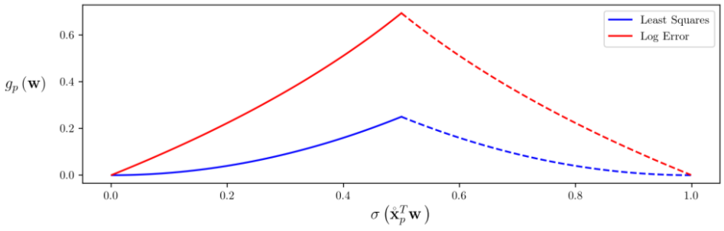

Slide 51
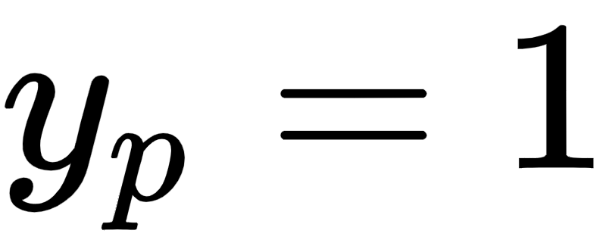
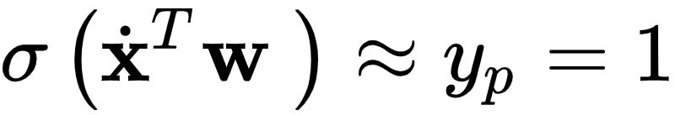

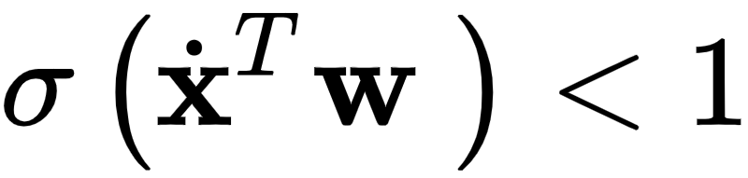
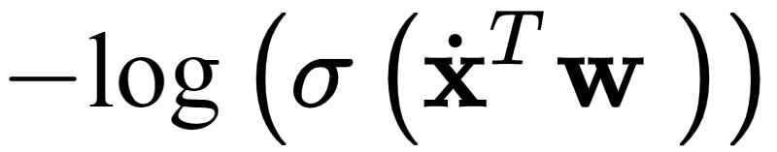
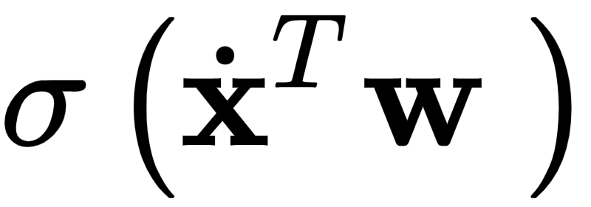
Suppose we have our optimally tuned our weights and that .
Then with our ideal weights we should satisfy our desired equality and have , and if this indeed the case then which is a neglibable penalty.
However if the value becomes large and positive very quickly harshly penalizing violations of our desired equality.
As approaches 0 - the worst possible value it could take on if indeed - then cost value goes to positive infinity.

Slide 52
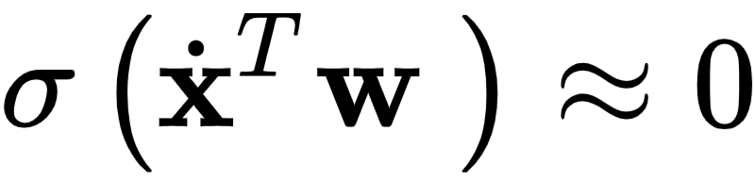


So indeed, this point-wise cost function penalizes violations when very strictly and is minimal (equals 0) in value when the desired equality holds.
Precisely the same thing can be said when that this point-wise cost takes on a minimal value when and is very large otherwise going to positive infinity as approaches the worst possible value of 1.
So - in short - point-wise cost severely punishes violations of our desired equalitiesa and takes on a minimum value of 0 when our weights are properly tuned i.e.,

Slide 53


We can then form the so-called Cross Entropy cost function by taking the average of the Log Error costs over all $P$ points as
Finally notice that we can write the Log Error equivalently - combining the two cases - in a single line as

Slide 54

We can form the same cost function as above by taking the average of this form of the Log Error giving
This is the more common way of expressing the Cross Entropy cost.

Slide 55

In any case, to recover the ideal weights that make the formulae in equation (4) hold as tightly as possible we want to minimize this cost over .
In other words, to optimally tune the parameters we want to minimize the Cross Entropy cost as

Slide 56
The Cross Entropy cost is always convex regardless of the dataset used.
We will see this empirically in the examples below and a mathematical proof is provided in the appendix of this Section that verifies this claim more generally.
We displayed a particular instance of the cost surface in the right panel of our first example above.

Slide 57
Since the Cross Entropy cost function is convex a variety of local optimization schemes can be more easily used to properly minimize it.
For this reason the Cross Entropy cost is used more often in practice for logistic regression than is the logistic Least Squares cost.

Slide 58
Implementing and minimizing a modular Cross Entropy cost in `Python`

Slide 59
We can implement the Cross Entropy costs very similarly to the way we did the Least Squares cost for linear regression, as detailed in [Section 5.2],
First we break down our implementation into the linear `model` and the error itself.

Slide 60


Our linear `model` takes in both an appended input point and a set of weights
With this notation for our model, the corresponding Cross Entropy cost in equation (16) can be written as

Slide 61


Slide 62


Slide 63
To minimize this cost we can use virtually any local optimization method detailed in Chapters 2 - 4. For first and second order methods (e.g., standard gradient descent and Newton's method schemes)
An Automatic Differentiator can be used - e.g., employing `autograd` as detailed in [Section 3.5] - to properly compute its gradient and Hessian.
Alternatively one can indeed compute the gradient and Hessian of the Cross Entropy cost in closed form, and implement them directly.

Slide 64
Example: Using gradient descent to perform logistic regression using the Cross Entropy cost

Slide 65


In this example we repeat the experiments of Example 2 using the Cross Entropy cost and gradient descent.
With our cost function defined in ``Python`` we can now run our demonstration. We initialize at the point and , set , and run for 25 steps.
Each step of the run is now animated - along with its corresponding fit to the data.

Slide 66


Slide 67
Below we show the result of running gradient descent with the same initial point and fixed steplength parameter for 2000 iterations, which results in a better fit.

Slide 68


